Slide 1
Comparative analysis of gene co-expression networks in breast cancer epithelium
Alexandra Rolya
2026.01.30

Slide 2
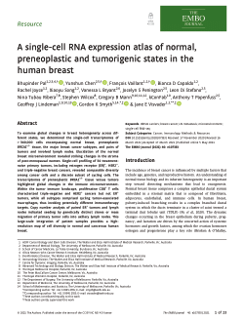
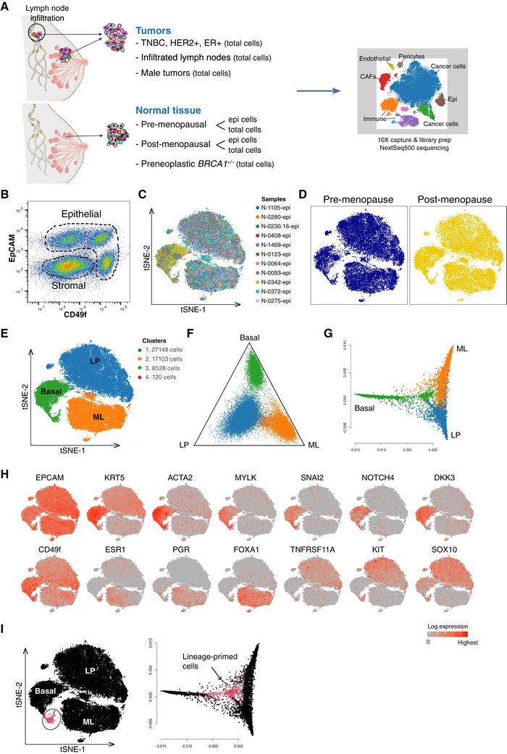
Total Samples: 69 unique biological samples across 6 molecular groups.
Normal (24 samples, 83,522 epithelial cells)
ER-positive (27 samples, 91,908 epithelial cells)
HER2-positive (6 samples, 19,693 epithelial cells)
Triple-negative (4 samples, 7,561 epithelial cells)
TN-BRCA1 (4 samples, 14,186 epithelial cells)
BRCA1 pre-neoplastic (4 samples, 7,644 epithelial cells)
Total Epithelial Cells: ~230,000 cells.
Note: not raw data
Pal, B., Chen, Y., Vaillant, F. et al. A single‐cell RNA expression atlas of normal, preneoplastic and tumorigenic states in the human breast. EMBO J 40, EMBJ2020107333 (2021). https://doi.org/10.15252/embj.2020107333
https://www.ncbi.nlm.nih.gov/geo/query/acc.cgi?acc=GSE161529

Slide 3
0. Getting data and harmonization
0.1 Source
All raw data sourced from GEO accession GSE161529 (10X genomics 3' scrna-seq):
Format: compressed matrixmarket count matrices, barcode files, and feature table (ensembl gene ids).
Reference genome: grch38 (33,514 genes total).
Structure: one count matrix per sample (genes × cells, sparse format).
0.2 Metadata integration and sample classification
Loaded sample-level metadata from GEO (titles, cell counts, accessions).
Consolidated table: thebigboss.Csv containing GEO ids, sample names, file paths, pre-qc cell counts and sample types.
Rule-based classification function classify_sample_type() to automatically assign each sample to biological category:
Normal (24 samples, 83,522 epithelial cells)
Er-positive (27 samples, 91,908 epithelial cells)
Her2-positive (6 samples, 19,693 epithelial cells)
Triple-negative (4 samples, 7,561 epithelial cells)
TN-BRCA1 (4 samples, 14,186 epithelial cells)
BRCA1 pre-neoplastic (4 samples, 7,644 epithelial cells)
0.3 Enhanced metadata table saved as TheBigBoss_enhanced.csv for downstream traceability.

Slide 4
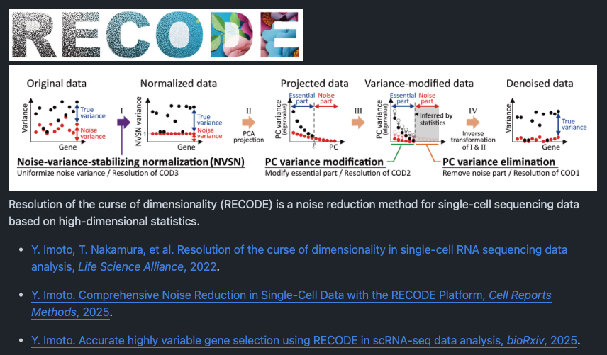
0.4 Getting data and harmonization
Per-sample data loading
Built load_sample(sample_row) helper function:
Reads compressed MatrixMarket (.mtx.gz), barcode, and feature files.
Transposes to cells × genes format.
Constructs AnnData object with cell/gene metadata.
Attaches sample-level annotations (name, type, GEO ID).
Validation with inspect_sample() computes per-sample statistics (UMI counts, gene counts, sparsity).
As per now, that data was already filtered, so that I only have epithelial cells
RECODE denoisification
Challenge:
Full datasets (e.g., ER-positive: 91,908 cells × 33,514 genes initially) exceed RAM capacity.
Solution: Implemented chunked processing pipeline
RECODE detects and removes technical noise.

Slide 5
0.4 Getting data and harmonization
Input: Raw count matrix per chunk (cells × genes, sparse).
Outputs: Denoised expression matrix, per-gene significance scores.
Result: "Significant genes" identified for each sample
Output files per sample:
*_RECODE_gene_stats.csv: Per-gene mean, variance, significance status.
*_RECODE_sig_genes_union.txt: Genes significant in ≥1 chunk.
*_RECODE_sig_genes_atleast2.txt: Genes significant in ≥2 chunks (robust set).
https://github.com/yusuke-imoto-lab/RECODE?tab=readme-ov-file
Accurate highly variable gene selection using RECODE in transcriptome data analysis
Yusuke Imoto
bioRxiv 2025.06.23.661026; doi: https://doi.org/10.1101/2025.06.23.661026

Slide 6
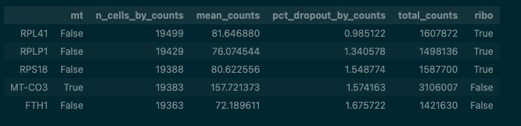
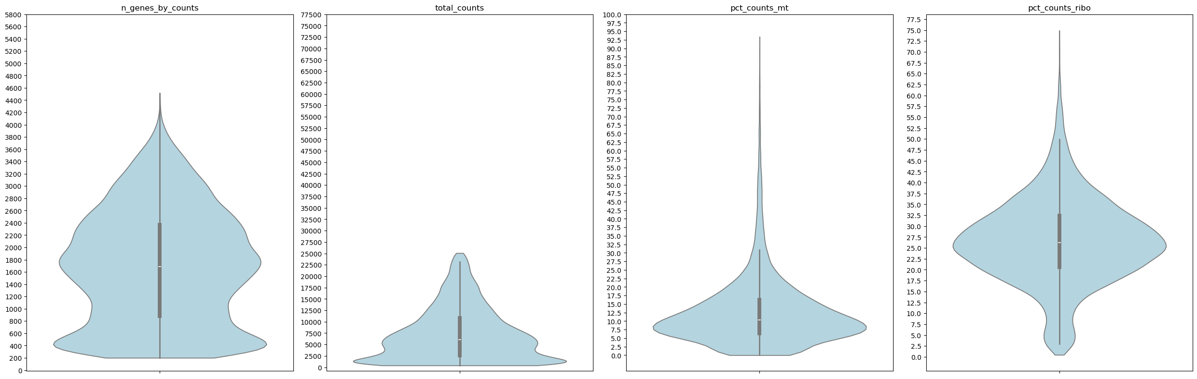
1. Quality control and per-sample filtering
1.1. QC Metrics Computation
For each sample, computed per-cell metrics:
n_counts: Total UMI per cell.
n_genes: Distinct genes detected per cell.
pct_mito: Percent mitochondrial transcript (flagged genes starting with "MT-").
pct_ribo: Percent ribosomal transcript (KEGG_RIBOSOME signature).
1.2 Data-driven thresholds
Quantile-based approach:
For each metric, computed violin plot whiskers (IQR ± 1.5×IQR).
Suggested thresholds:
min_genes: max(200, lower whisker).
max_genes: upper whisker (removes doublets/extreme complexity).
max_counts: upper whisker (removes doublets).
max_pct_mito: upper whisker, capped at 20% (cancer cells have elevated mito; no aggressive filtering).
QC summary for HER2_positive
n_genes_by_counts: median=1722.0, IQR=[888.0, 2458.0], whiskers≈[-1467.0, 4813.0], min=33.0, max=5397.0
total_counts: median=6332.0, IQR=[2602.0, 11602.0], whiskers≈[-10898.0, 25102.0], min=403.0, max=71386.0
pct_counts_mt: median=10.2, IQR=[6.4, 16.1], whiskers≈[-8.3, 30.8], min=0.0, max=97.1
pct_counts_ribo: median=26.3, IQR=[20.6, 32.3], whiskers≈[3.0, 49.9], min=0.4, max=75.3
Suggested QC thresholds (from violins): min_genes: 200.00 max_genes: 4813.00 max_counts: 25102.00 max_pct_mt: 20.00

Slide 7
1. Quality control and per-sample filtering
1.3 Cell and gene filtering
Cell filtering:
Applied thresholds uniformly: n_genes and total_counts within suggested bounds.
Gene filtering:
Removed rare genes (detected in < 3 cells).
Example (HER2+):
Cells before QC: 19693
Cells after QC: 18762
18762 cells remain after QC
Capped to 10 000 genes for visualization
1.4 Mitochondrial flagging (per-cluster)
For tumor samples (Her2+, ER+, TN, TN-BRCA1, BRCA1 pre-neoplastic)
Computed mean pct_mito per Leiden cluster (post-clustering).
Data-driven threshold: upper whisker of global pct_mito distribution.
Flagged clusters as "high_mt_cluster" if mean exceeded threshold.
Reason: Cancer cells exhibit elevated mitochondrial content; I ”reserved” flagged clusters reserved laterinterpretation (no automatic removal).

Slide 8
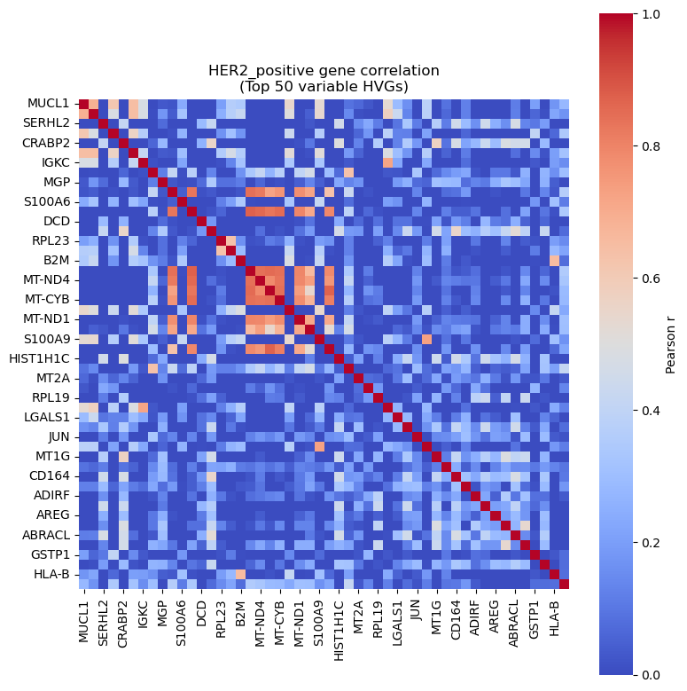
1. Quality control and per-sample filtering
1.5 Library size normalization and log transformation
Counts-per-10,000 (CP10k) + log1p
Scale each cell to 10,000 total counts:
norm = (counts / sum(counts)) × 10,000
Log-transform: log1p = log(norm + 1)
Chunked implementation:
Read full RECODE matrix in chunks
Normalize and log-transform per chunk
Append sequentially to output CSV
Reason: CP10k + log1p is standard for scRNA-seq; chunking avoids RAM overflow on large datasets
1.6 HVG selection via variance
Per-gene variance calculated across all cells
Pass 1 (means): Iterate through chunks, accumulate ΣX and ΣX².
Pass 2 (variance): mean = ΣX / n, var = ΣX² / n - mean².
Selection: Top 3,000 genes by variance (consistent across samples)
Output: HVG lists saved as *_HVG_3000.txt per sample
Notes:
Library size normalization (CP10k)
Different cells are sequenced to different depths: one cell might have 5,000 UMIs, another 50,000, even if they had the same true RNA content.
IF I would used a raw counts, the deeper‑sequenced cell would look “more expressed” for every gene just because I counted more molecules, not because that cell is biologically more active.
Dividing by the cell’s total counts and scaling to 10,000 makes every cell comparable: “Out of 10,000 transcripts in this cell, how many are gene X?”.
I believe biologically this still makes sense, this makes expression values relative abundances per cell, so differences across cells now reflect changes in composition of the transcriptome rather than raw sequencing depth.
Log1p transform
Gene counts are very skewed: a few genes are extremely highly expressed while many are low or zero and their variance grows with the mean.
Taking log1p compresses large values and spreads out small ones, which stabilizes variance and prevents highly expressed genes (like RPLs, mitochondrial genes) from dominating PCA, clustering, etc.
Log1p also makes fold‑changes additive: a 2‑fold increase becomes roughly a fixed difference on the log scale, which is easier to model and interpret in linear methods like PCA.
So, CP10k + log1p turns raw UMI counts into comparable, variance‑stabilized, relative expression measures, letting you see biological structure (cell types, states) rather than technical noise.
If a gene has almost the same expression in every cell, it carries little information about differences between cells
Genes whose expression varies a lot between cells are usually the ones marking cell types, activation states, or pathways turning on/off, so they are informative for clustering and trajectories.
So taking per‑gene variance across cells is a simple way to measure “how much does this gene help tell cells apart?”.
I pick top 3000 HVGs
using the most variable few thousand preserves almost all structure of cell heterogeneity.
Why is the two‑pass ΣX / ΣX² trick OK?
The ΣX / ΣX² passes are a numerically stable way to compute the same variance I’d get if you had the full matrix in memory; it doesn’t change the statistic, it just avoids memory issues.
Biologically I are still ranking genes by “how much they fluctuate across cells,” which is the same concept as in standard HVG selection methods (Seurat, scran, etc.).
So conceptually: I first normalize counts so cells are comparable, then I keep the genes whose expression varies the most across those comparable cells, because those genes are the ones that encode meaningful biological differences, and I use a chunked variance computation purely as an efficient implementation detail.

Slide 9
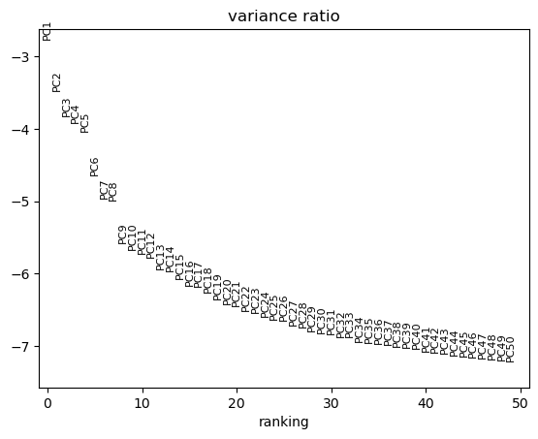
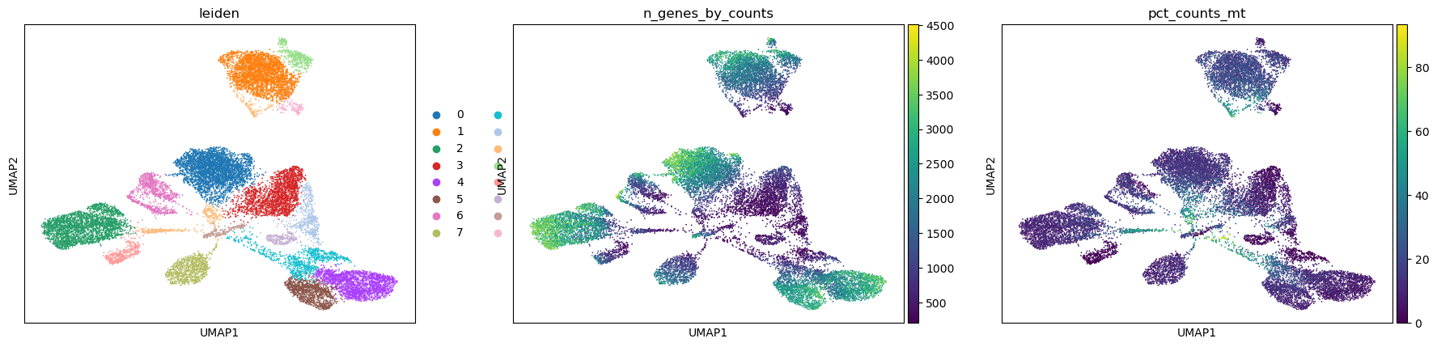
2. Clustering and cell state characterization
2.1 Dimensionality reduction and clustering
Scaling: sc.pp.scale() (max_value=10)
PCA: Computed on HVG-subset using ARPACK solver.
Neighbours: Built k-NN graph (k=15) in first 20–30 PC space.
UMAP
Leiden clustering
Output:
UMAP coordinates appended to .obs.
Cluster assignments.
Frozen AnnData saved per sample (e.g., adata_ERpositive_HVG_UMAP_leiden_frozen.h5ad).

Slide 10
2. Clustering and cell state characterization
2.2 Marker gene discovery
Wilcoxon rank-sum test via sc.tl.rank_genes_groups().
Tests each cluster vs. all other cells.
Computes log2-fold-change and p-value per gene.
Output: Top 20 marker genes per cluster.
Gene annotation fix:
Initial marker lists referenced Ensembl IDs only.
Loaded external feature table (GSE161529_features.tsv):
gene_id → gene_name mapping.
Rebuilt adata.var['gene_name'] with correct human-readable symbols.
Remapped marker lists for biological interpretation.
Saved: Cluster marker dictionaries as .pkl files per sample.
Notes:
Wilcoxon rank-sum is a way to ask: Are two groups different? without assuming the data is normally distributed (bell-curve shaped).
It works by ranking all values together, summing the ranks for each group and checking if one group's ranks are consistently higher.
It's powerful because it doesn't assume your data is normally distributed and it's resistant to outliers.
I used it in scRNA-seq to find genes that are significantly different between cell types or conditions.

Slide 11
3. Network construction via chunked correlation
3.1 Pearson correlation matrix (3000 × 3000)
Challenge: Computing full correlation matrix for 3,000 HVGs across 70,000+ cells in memory.
Solution: Two-pass algorithm:
Pass 1 (means):
Iterate through chunks (1,000–2,000 cells):
Accumulate ΣX and ΣX² per gene
Compute: gene_mean = ΣX / n_cells gene_std = sqrt(ΣX² / n - mean²)
Pass 2 (covariance)
Center each chunk: ch_centered = ch_values - gene_mean_corr Accumulate covariance: cov_matrix += ch_centered.T @ ch_centered Normalize: cov_matrix /= n_cells_corr # converting sum to covariance
corr_matrix = cov_matrix / np.outer(gene_std, gene_std) # rescaling by variability
corr_matrix = np.clip(corr_matrix, -1, 1) # Ensuring [-1, 1] range
Computing gene-gene correlation (pass 1: means)
Pass 1 complete: 18762 cells processed
Computing gene-gene correlation (pass 2: covariance)
Correlation matrix shape: (3000, 3000)
Min correlation: -0.685
Max correlation: 1.000
Notes:
Pass 1:
I read 1,000 cells at a time (to fit in RAM).
For each gene, I accumulate the sum of all its expression values across those cells.
I also accumulate the sum of squares (needed to compute variance later).
I keep a running total of all cells processed.
Why this preserves biology:
I am not modifying the data or averaging chunks separately; I am just accumulating the same raw sums you would get if I loaded all cells at once.
The final mean gene_mean = gene_sum / n_cells_corr is exactly the same as computing it on the full dataset; chunking is invisible to the final result Pass 2:
For each chunk, I subtract the overall gene mean (from Pass 1) from each cell's values.
This "centers" the data: now 0 means "average expression," positive means "above average," negative means "below average."
I compute cov_matrix += ch_centered.T @ ch_centered a matrix product that accumulates for each pair of genes, how often they're both above or both below their average together.
I add this to cov_matrix, so by the end I have the sum across all cells.
Why this preserves biology:
Centering doesn't change the data, it just makes 0 the reference point.
The covariance accumulation cov_matrix += ch_centered.T @ ch_centeredis still computing correlation in the honest way.
The final covariance cov_matrix / n_cells_corr is exactly the sample covariance you'd compute on the full matrix.
cov_matrix / n_cells_corr = average covariance per cell pair (true covariance matrix).
np.outer(gene_std, gene_std) = creates a matrix where entry (i,j)(i,j) is σi×σjσi×σj.
Dividing covariance by that product gives Pearson correlation r=covσiσjr=σiσjcov, which ranges from −1 to +1.
Clipping ensures no numerical errors push it outside [−1, 1].
definition of Pearson correlation.
rescaling covariance by the variability of each gene so comparisons are fair.
I loaded cells in chunks (1,000 at a time) and accumulate the sums and sums-of-squares needed to compute means and standard deviations.
Then I reloaded the chunks and center each one by subtracting the overall gene means.
I accumulated how often gene pairs move together above or below their average, then divided by their variabilities to get Pearson correlation.
The chunking is a memory trick—the final correlation matrix is identical to what you'd get loading all cells at once.
I find the average expression level for each gene (Pass 1). Then I check: for each cell, is that gene above or below its average? I count how often two genes are both above average together, or both below average together—that's how correlated they are (Pass 2). Chunking doesn't change this because I compute the overall average first, then use that same average for all chunks.

Slide 12
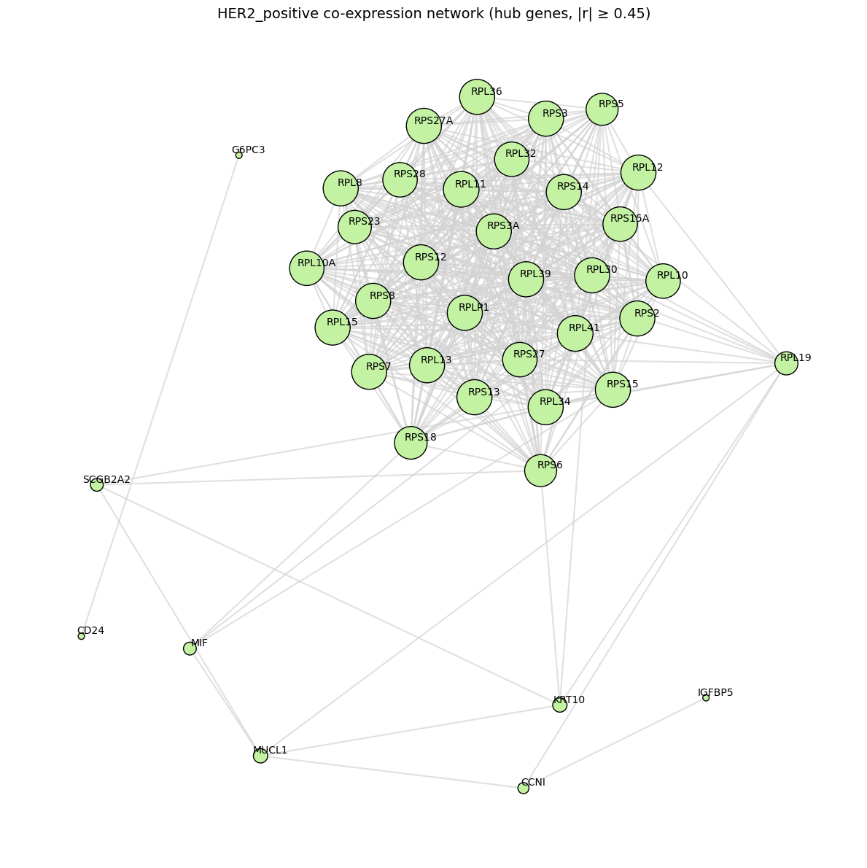
3. Network construction via chunked correlation
3.2 Network edge construction
Threshold: |r| ≥ 0.45 (+checking other threshholds)
Edge list:
For each gene pair (i, j) where |corr[i,j]| ≥ 0.45, create edge with weight = r.
Building network with |r| >= 0.45
Found 4966 edges
Network: 3000 nodes, 4966 edges
3.3 Community detection (louvain algorithm)
Louvain modularity optimization (networkx).
Input: full network (3,000 nodes, ~15k–25k edges).
Output: gene-to-module assignment.
Example (her2+):
Detecting modules with louvain found 2391 modules
Module sizes: min=1, max=154, median=1

Slide 13
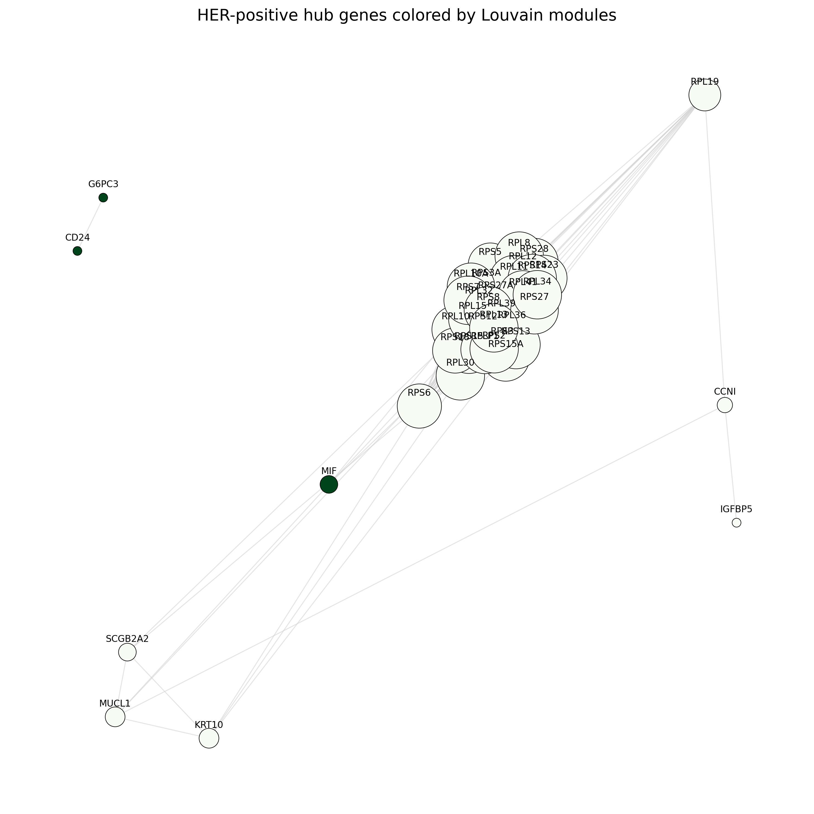
3. Network construction via chunked correlation
3.2 Network edge construction
Threshold: |r| ≥ 0.45 (+checking other threshholds)
Edge list:
For each gene pair (i, j) where |corr[i,j]| ≥ 0.45, create edge with weight = r.
Building network with |r| >= 0.45
Found 4966 edges
Network: 3000 nodes, 4966 edges
3.3 Community detection (louvain algorithm)
Louvain modularity optimization.
Input: full network (3,000 nodes, ~15k–25k edges).
Output: gene-to-module assignment.
Example (her2+):
Detecting modules with louvain found 2391 modules
Module sizes: min=1, max=154, median=1
Notes:
Louvain is a community detection algorithm that finds groups (modules) of genes that are tightly connected to each other in the co-expression network.
It works by moving genes between groups and keeping them where they have the strongest connections.
The result is a set of modules where genes in the same module likely share biological functions.
I used this to simplify the network into interpretable groups and identify hub genes within each module.

Slide 14
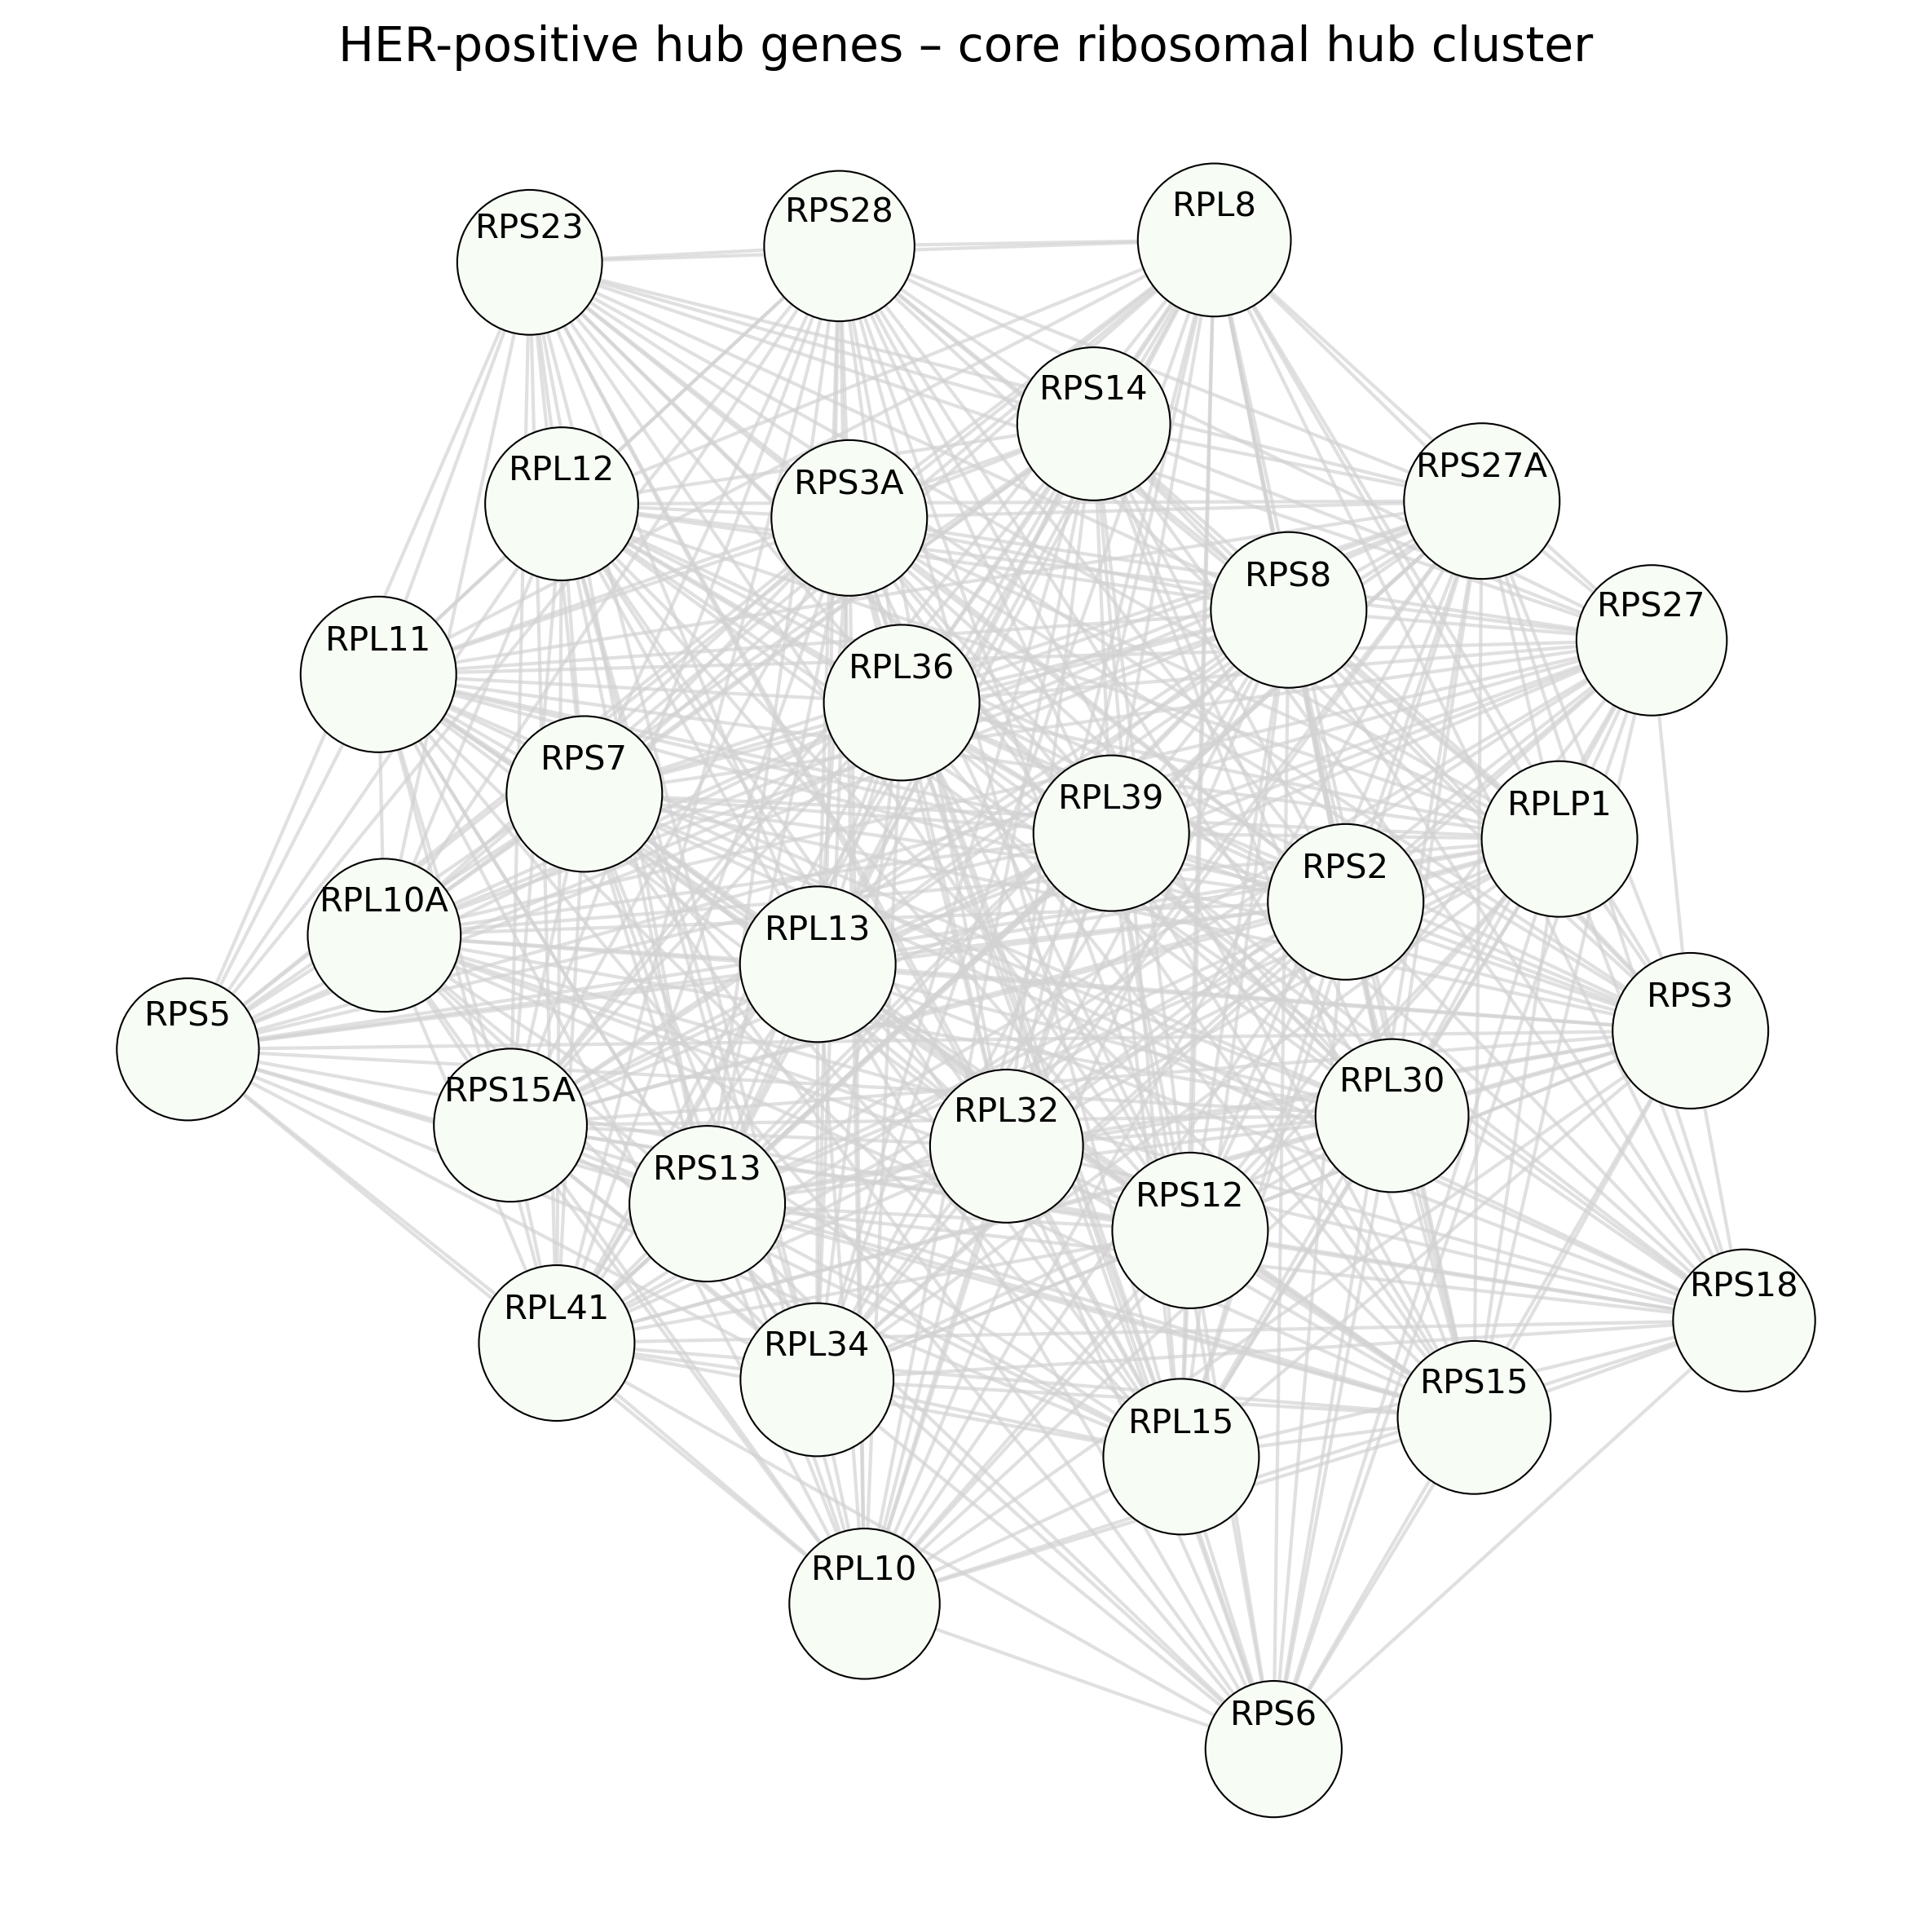
3. Network construction via chunked correlation
3.2 Network edge construction
Threshold: |r| ≥ 0.45 (+checking other threshholds)
Edge list:
For each gene pair (i, j) where |corr[i,j]| ≥ 0.45, create edge with weight = r.
Building network with |r| >= 0.45
Found 96 edges
Network: 3000 nodes, 96 edges
3.3 Community detection (louvain algorithm)
Louvain modularity optimization (networkx).
Input: full network (3,000 nodes, ~15k–25k edges).
Output: gene-to-module assignment.
Example (er-positive):
Found 2961 modules
3.4 Hub gene extraction

Slide 15
3. Network construction via chunked correlation
3.2 Network edge construction
Threshold: |r| ≥ 0.45 (+checking other threshholds)
Edge list:
For each gene pair (i, j) where |corr[i,j]| ≥ 0.45, create edge with weight = r.
Building network with |r| >= 0.45
Found 96 edges
Network: 3000 nodes, 96 edges
3.3 Community detection (louvain algorithm)
Louvain modularity optimization (networkx).
Input: full network (3,000 nodes, ~15k–25k edges).
Output: gene-to-module assignment.
Example (her-positive):
Found 2391 modules
3.4 Hub gene extraction
3.5 Largest connected plot
Largest component: 594 nodes, 4926 edges

Slide 16
4. Troubleshooting
RAM and server overload
Loading full 91,000 cells × 33,000 genes into memory exceeds typical system capacity.
Solution: chunked processing, but, preserving biological meaning of data
Decomposed large matrices into smaller cell chunks.
Having terminal opened and looking at the CPU%
5. To do
5.1 Combined approach
When having two conditions (e.g. treatment vs control), I can build co‑expression networks in two ways:
Combined network: pool all samples and build one network. This is best to find modules that are conserved across conditions, representing core pathways that are stable and not strongly altered by treatment/disease.
Separate networks: build one network per condition. This is best to find condition‑specific modules and hubs, compare connectivity and module composition and detect pathways that are disrupted only in the disease (e.G. 5xfad) or only present in normal regulation.
A common strategy is stepwise: build both
5.2 Leiden clusters
I have the clustering results from the data presented with the article, I want to refine my clustering
+ Would be nice to add more plots vizualizing the data
5.3 Hub gene functional validation
5.4 Different correlation thresholds (I have checked several within all samples, but I should make it more comparable and consistent)
5.5. Build a proper github repo, never done before with this much data

